Slide 1
CS7/8745 : Machine Learning Instructor: Salim Sazzed Department of Computer Science University of Memphis

Slide 2
Week 2, Class 1

Slide 3
Recap

Slide 4
https://www.youtube.com/watch?v=HcqpanDadyQ

Slide 5
Rule-based system Vs Learning-based System
Rule-Based Systems:
Operates based on a set of predefined rules.
Rules are explicitly programmed to describe how the system should make decisions or take actions in various situations.
Rule-based systems rely on a knowledge base of if-then rules, where the "if" part represents the conditions or inputs, and the "then" part represents the actions or outputs.
Follow the rules in a deterministic manner and don't involve learning from data.
Machine Learning:
Teach a computer to learn concepts using data or interactions with an environment– without being explicitly programmed
It focuses on the development of computer programs that can adapt when exposed to new data
https://www.youtube.com/watch?v=_N2iIB_bLXA

Slide 6

Supervised Machine learning
Testing
Training
New Data
Data
Output
Program
Output
Example by Dr. Kilian Weinberger

Slide 7
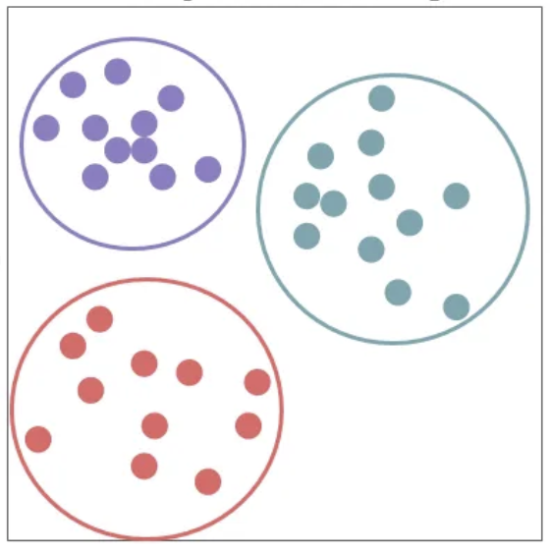
Unsupervised Learning

Slide 8
Semi-supervised Learning
Assume a set L of labeled data and U of unlabeled data (from the same distribution)
Self-Training (a simple algorithm)
Train a supervised model on labeled data L
apply on unlabeled data U
Add the most confidently classified members of U to L
Repeat
Slide modified from Stanford CS329, Fall-2021

Slide 9
New Topics

Slide 10
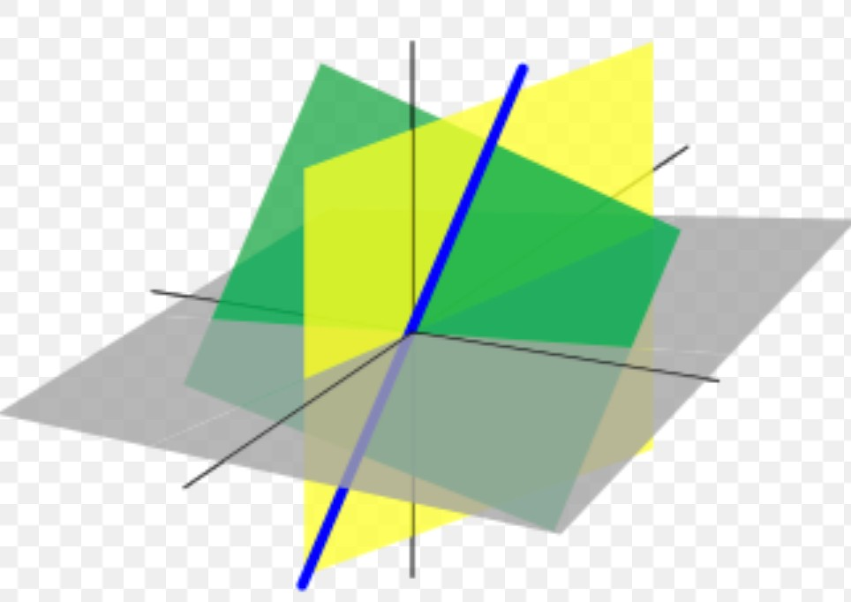
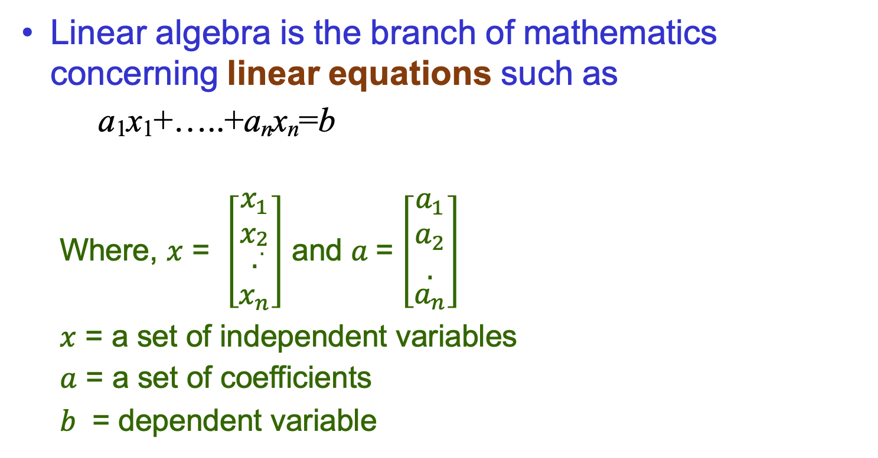

What is linear algebra?
Linear algebra is the branch of mathematics concerning linear equations such as
a₁x₁+…..+a_{n}x_{n}=b
Where, $x$ = $\left[\begin{matrix}x_{1} \\ x_{\begin{aligned}2 \\ .\end{aligned}} \\ \begin{aligned}. \\ x_{n}\end{aligned}\end{matrix}\right]$ and $a$= $\left[\begin{aligned}\begin{matrix}a_{1} \\ a_{2} \\ .\end{matrix} \\ a_{n}\end{aligned}\right]$
$x$ = a set of independent variables
$a$ = a set of coefficients
$b$ = dependent variable
Dependent variable
$x$ = independent variables
Slide modified from Sargur N. Srihari

Slide 11
Linear algebra is fundamental to geometry, for defining objects such as lines, planes, rotations
Essential for understanding ML algorithms
E.g., We convert input vectors (x₁,..,x_{n}) into outputs by a series of linear transformations
Here we discuss:
Concepts of linear algebra needed for ML
Omit other aspects of linear algebra

Slide 12
Topics in Linear Algebra for ML
Vector and Matrix
Know how to do matrix-matrix addition/multiplication and its rules
Identity Matrix, Determinant, Inverse Matrix.

Slide 13
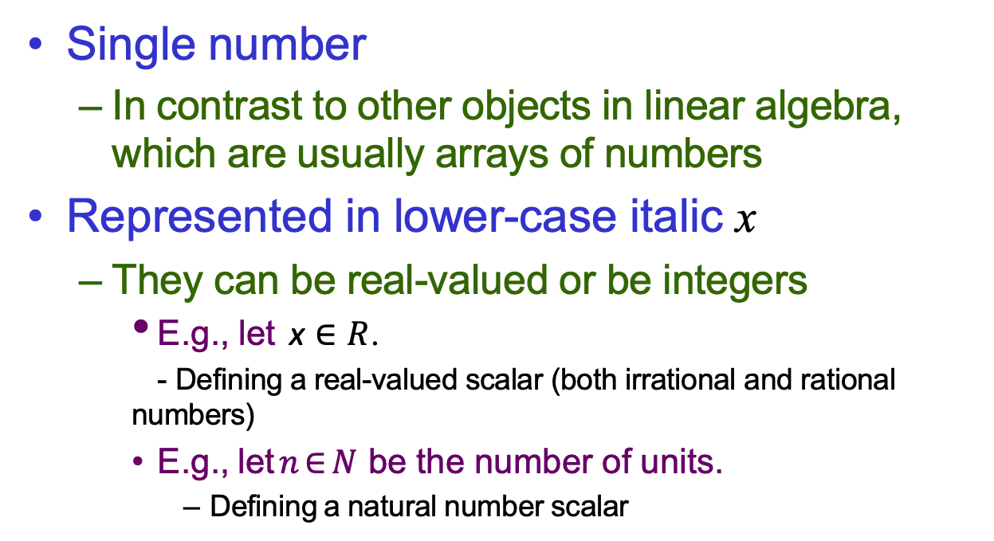
Scalar
Single number
In contrast to other objects in linear algebra, which are usually arrays of numbers
Represented in lower-case italic x
They can be real-valued or be integers
E.g., let x $∈R$.
- Defining a real-valued scalar (both irrational and rational numbers)
E.g., let $n∈N$ be the number of units.
Defining a natural number scalar

Slide 14


Vector
An array/sequence of numbers arranged in order
Each number is identified by an index
Written in lower-case bold such as x
– its elements are in italics lower case, subscripted
]
]
$$\begin{matrix}x_{1} \\ \begin{aligned}x_{2} \\ . \\ . \\ x_{n}\end{aligned}\end{matrix}$$
$$X=$$
If each element is in R then x is in R
n
We can think of vectors as points in space
– Each element gives coordinate along an axis

Slide 15
Norm of a vector
Vector norms are mathematical concepts that assign a non-negative length or size to vectors in a vector space.
They are used to quantify the "size" or "magnitude" of vectors and are essential in various mathematical and scientific fields, including linear algebra, calculus, optimization, and signal processing.
Different vector norms exist, each with its own properties and applications.
These vector norms have various applications in machine learning, optimization, signal processing, and other fields.
The choice of which norm to use depends on the specific problem and the properties you want to emphasize in the vectors you are working with.

Slide 16
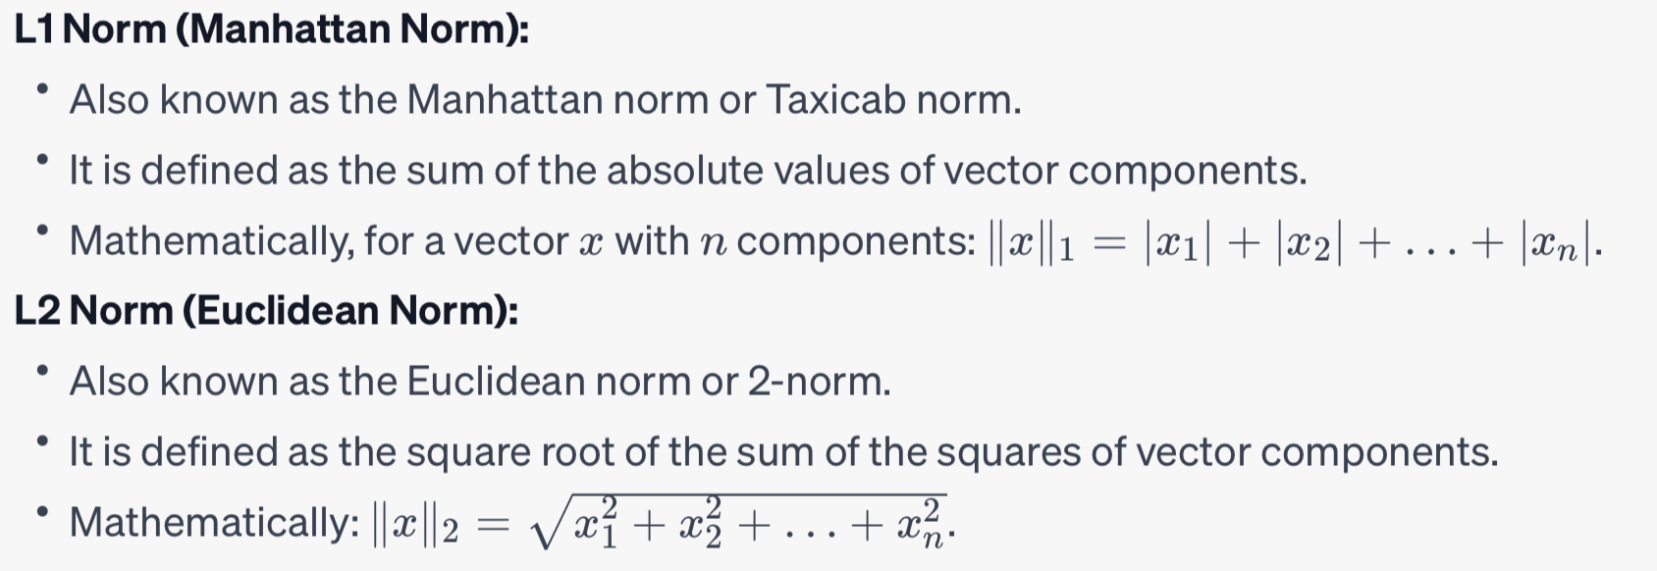
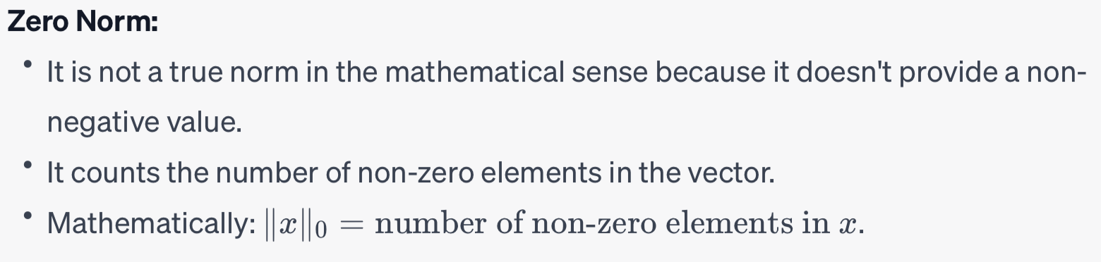
Norm of a Vector

Slide 17
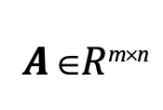
Matrix
2-D array of numbers
– So each element identified by two indices
Denoted by bold typeface A
Elements indicated by name in italic but not bold
A_{1,1} is the top left entry and A_{m,n} is the bottom right entry
We can identify nos in vertical column j by writing : for the horizontal coordinate
E.g.,
⎡ _{A}
A
⎤
⎥
A = ⎢
1,1
1,2
⎢ A
A
⎥
⎣ ⎦
2,1 2,2
A_{i:} is i^{th} row of A, A_{:j} is j^{th} column of A
If A has shape of height m and width n with real-
values then
_{A ∈}$R$m×n

Slide 18
Transpose of a Matrix
An important operation on matrices
The transpose of a matrix A is denoted as A^{T}
Defined as
^{(AT)}i,j^{=A}j,i
The mirror image across a diagonal line
Called the main diagonal , running down to the right starting from upper left corner
⎡ _{A}
A A
⎤
⎡ _{A}
A A
⎤
⎥
⎥
⎥
⎡ _{A}
A
⎤
⎡ _{A}
A A
⎤
⎥
⎥
⎥
⎢
1,1
1,2
1,3
⎥
⎢
1,1
2,1
3,1
⎢
1,1
1,2
⎥
⎢
1,1
2,1
3,1
A = ⎢ A A A ⎥ ⇒ A^{T} = ⎢ A
A A
A = ⎢ A A
⎥ ⇒ A^{T} = ⎢ A A A
2,3
⎢ A A A
3,1 3,2 3,3
⎢
2,1
2,2
⎥
⎢
1,2
2,2
3,2
⎢
2,1
2,2
⎥
⎢
1,2
2,2
3,2
⎥
⎥
⎢ A A
1,3 2,3
^{A}3,3
⎥
⎢ A A
3,1 3,2
⎢
⎥
⎣
⎦
⎣
⎦
⎣
⎦
⎣
⎦

Slide 19

A =$\left[\begin{matrix}1 & 2 \\ 3 & 4\end{matrix}\right]$
What would be the A^{T}?
1. A^{T} =$\left[\begin{matrix}1 & 3 \\ 2 & 4\end{matrix}\right]$ 2. A^{T} =$\left[\begin{matrix}2 & 1 \\ 4 & 3\end{matrix}\right]$ 3. A^{T} =$\left[\begin{matrix}3 & 4 \\ 1 & 2\end{matrix}\right]$

Slide 20
Vectors can be considered as special case of matrix
Vectors are matrices with a single column
Often written in-line using transpose
x = [x₁,..,x_{n}]^{T}
⎡ _{x} ⎤
⎢ ⎥
1
⎢ x ⎥
2
x = ⎢
⎢ ⎥
T
⎤
⎥
⇒ x = ⎡x ,x ,..x
⎢ ⎥
⎢ _{x} ⎥
⎣ 1 2 n ⎦
⎢ n ⎥
⎢⎣ ⎥⎦
A scalar is a matrix with one element
a=a^{T}

Slide 21
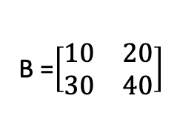
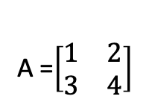
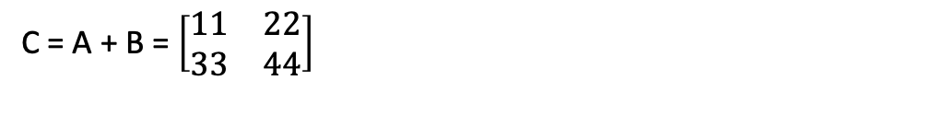
Matrix Addition
We can add matrices to each other if they have the same shape, by adding corresponding elements
– If A and B have same shape (row m, column n)
C =A+B ⇒C_{i,j} = A_{i,j} +B_{i,j}
A scalar can be added to a matrix or multiplied
by a scalar
D=aB+c ⇒ D_{i,j} =aB_{i,j} +c
A =$\left[\begin{matrix}1 & 2 \\ 3 & 4\end{matrix}\right]$
B =$\left[\begin{matrix}10 & 20 \\ 30 & 40\end{matrix}\right]$
C = A + B = $\left[\begin{matrix}11 & 22 \\ 33 & 44\end{matrix}\right]$

Slide 22
Week 2
(Class 2)

Slide 23

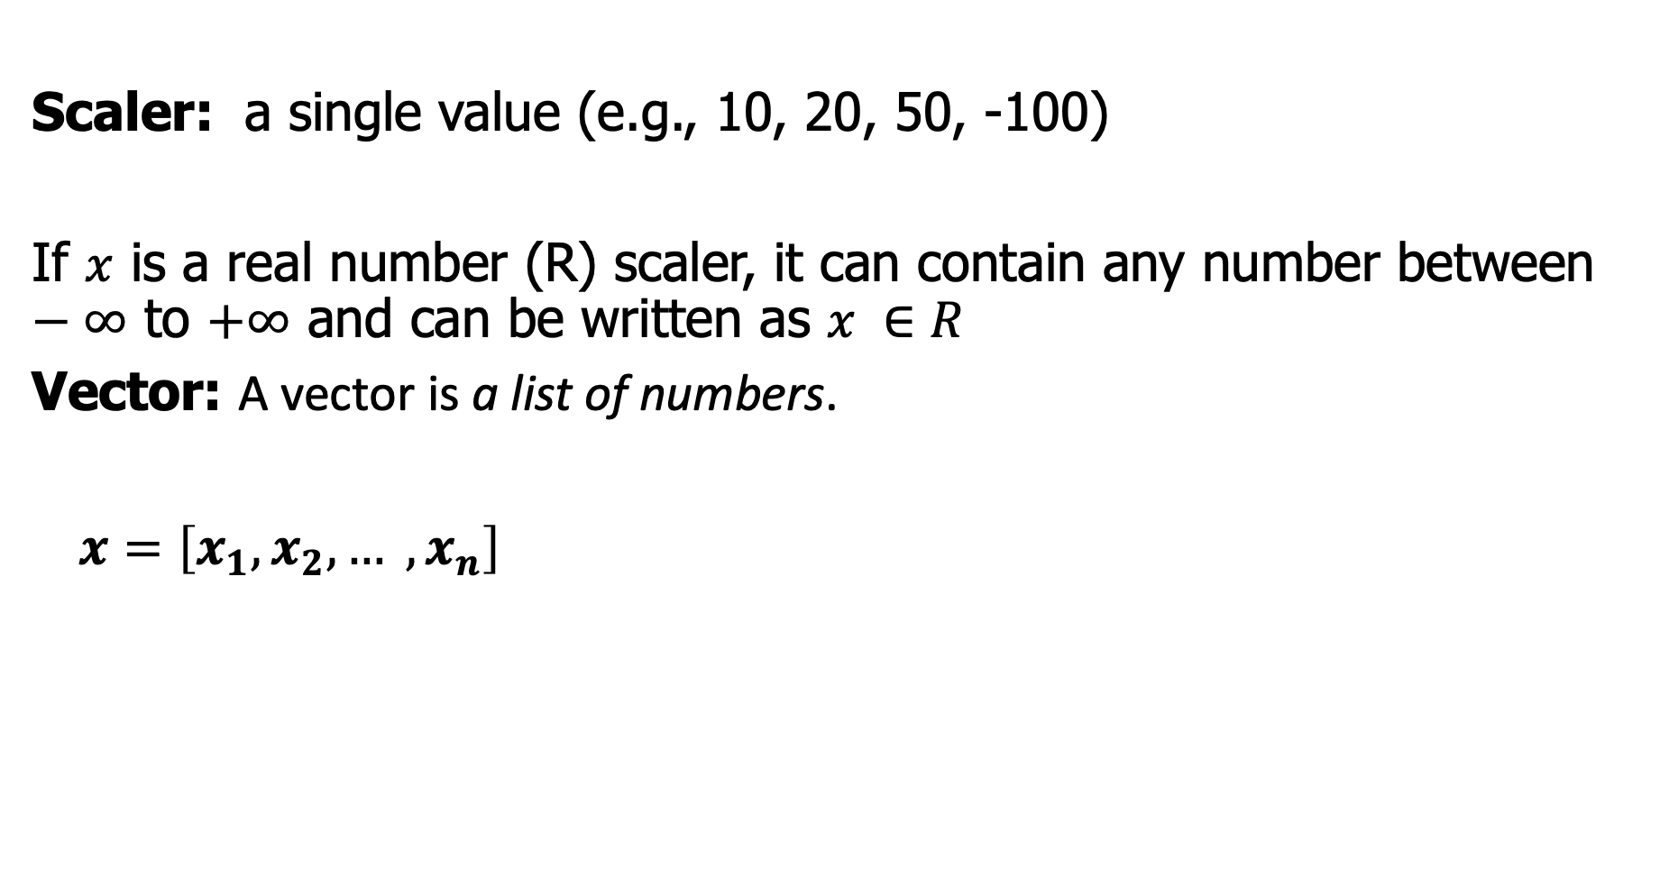

Recap:
Scaler: a single value (e.g., 10, 20, 50, -100)
If $x$ is a real number (R) scaler, it can contain any number between $−∞$ to $+∞$ and can be written as $x ∈R$
Vector: A vector is a list of numbers.
$x=\left[x_{1},x_{2},… ,x_{n}\right]$
Row vector
]
]
$$\begin{matrix}x_{1} \\ \begin{aligned}x_{2} \\ . \\ . \\ x_{n}\end{aligned}\end{matrix}$$
$$X=$$
Column vector

Slide 25
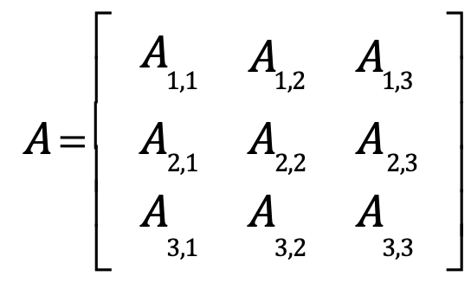
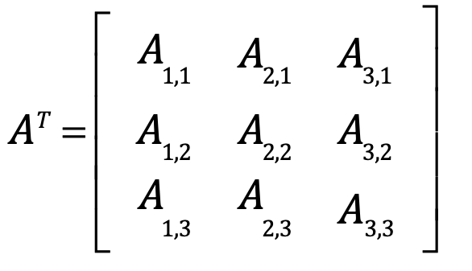
Matrix: can be considered as a collection of vectors
Transpose of a vector:

Slide 26
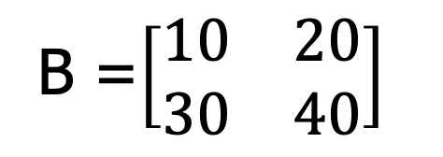
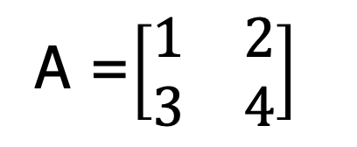
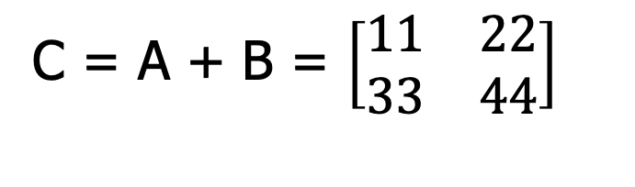
Matrix Addition:
A =$\left[\begin{matrix}1 & 2 \\ 3 & 4\end{matrix}\right]$
B =$\left[\begin{matrix}10 & 20 \\ 30 & 40\end{matrix}\right]$
C = A + B = $\left[\begin{matrix}11 & 22 \\ 33 & 44\end{matrix}\right]$

Slide 27
New Topics

Slide 28



Matrix Multiplication
For product C=AB to be defined, A has to have the same no. of columns as the no. of rows of B
– If A is of shape mxn and B is of shape nxp then
matrix product C is of shape mxp
C =AB ⇒C_{i,j} = ∑A_{i,k}B_{k,j}
k
A =$\left[\begin{matrix}2 & 1 \\ 0 & −1\end{matrix}\right]$
B =$\left[\begin{matrix}3 & 4 \\ 5 & 6\end{matrix}\right]$
We want to compute C = A * B.
The resulting matrix C will be a 2x2 matrix, and its elements will be computed as follows:
C[1][1] = (2 * 3) + (1 * 5) = 6 + 5 = 11
C[1][2] = (2 * 4) + (1 * 6) = 8 + 6 = 14
C[2][1] = (0 * 3) + (-1 * 5) = 0 - 5 = -5
C[2][2] = (0 * 4) + (-1 * 6) = 0 - 6 = -6
C =$\left[\begin{matrix}11 & 14 \\ −5 & −6\end{matrix}\right]$

Slide 29
Multiplying Vectors
Machine Learning Srihari
Dot product between two vectors x and y of same dimensionality is the matrix product x^{T}y
We can think of matrix product C=AB as computing C_{ij} the dot product of row i of A and column j of B

Slide 30
Matrix and Vector Properties
Distributivity over addition: A(B+C)=AB+AC
Associativity: A(BC)=(AB)C
Not commutative (in general): AB!=BA
Order matters
Why not multiplicative?
What about addition?
Dot product between vectors is commutative:
x^{T}y=y^{T}x
Transpose of a matrix product has a simple form: (AB)^{T}=B^{T}A^{T}

